Slide 1
De-centralized but global:
Redesigning biodiversity data aggregation
for improved engagement and impact
Nico Franz, Ed Gilbert & Beckett Sterner
Biodiversity Knowledge Integration Center – Arizona State University
Keynote Session – June 10, 2019
3rd Annual Digital Data Conference – Yale University, New Haven, CO

Slide 2
Structure of presentation
0. Key message: Biodiversity informatics remains young and fresh; especially if we aim
to incentivize experts/enthusiasts in publishing high-quality,
"data-intelligent" biodiversity data products.

Slide 3
Structure of presentation
0. Key message: Biodiversity informatics remains young and fresh; especially if we aim
to incentivize experts/enthusiasts in publishing high-quality,
"data-intelligent" biodiversity data products.
1. "New at ASU" (and more generally): The NEON Biorepository Data Portal –
a Darwin Core-based ecological monitoring and forecasting resource.

Slide 4
Structure of presentation
0. Key message: Biodiversity informatics remains young and fresh; especially if we aim
to incentivize experts/enthusiasts in publishing high-quality,
"data-intelligent" biodiversity data products.
1. "New at ASU" (and more generally): The NEON Biorepository Data Portal –
a Darwin Core-based ecological monitoring and forecasting resource.
2. Rethinking centralized biodiversity data aggregation: Diagnosis and components
of a de-centralized complement.

Slide 5
Structure of presentation
0. Key message: Biodiversity informatics remains young and fresh; especially if we aim
to incentivize experts/enthusiasts in publishing high-quality,
"data-intelligent" biodiversity data products.
1. "New at ASU" (and more generally): The NEON Biorepository Data Portal –
a Darwin Core-based ecological monitoring and forecasting resource.
2. Rethinking centralized biodiversity data aggregation: Diagnosis and components
of a de-centralized complement.
3. Still our frontier: Taxonomic data intelligence for Darwin Core occurrences.

Slide 6
Introducing the NEON Biorepository Data Portal (1)
https://biorepo.neonscience.org

Slide 7
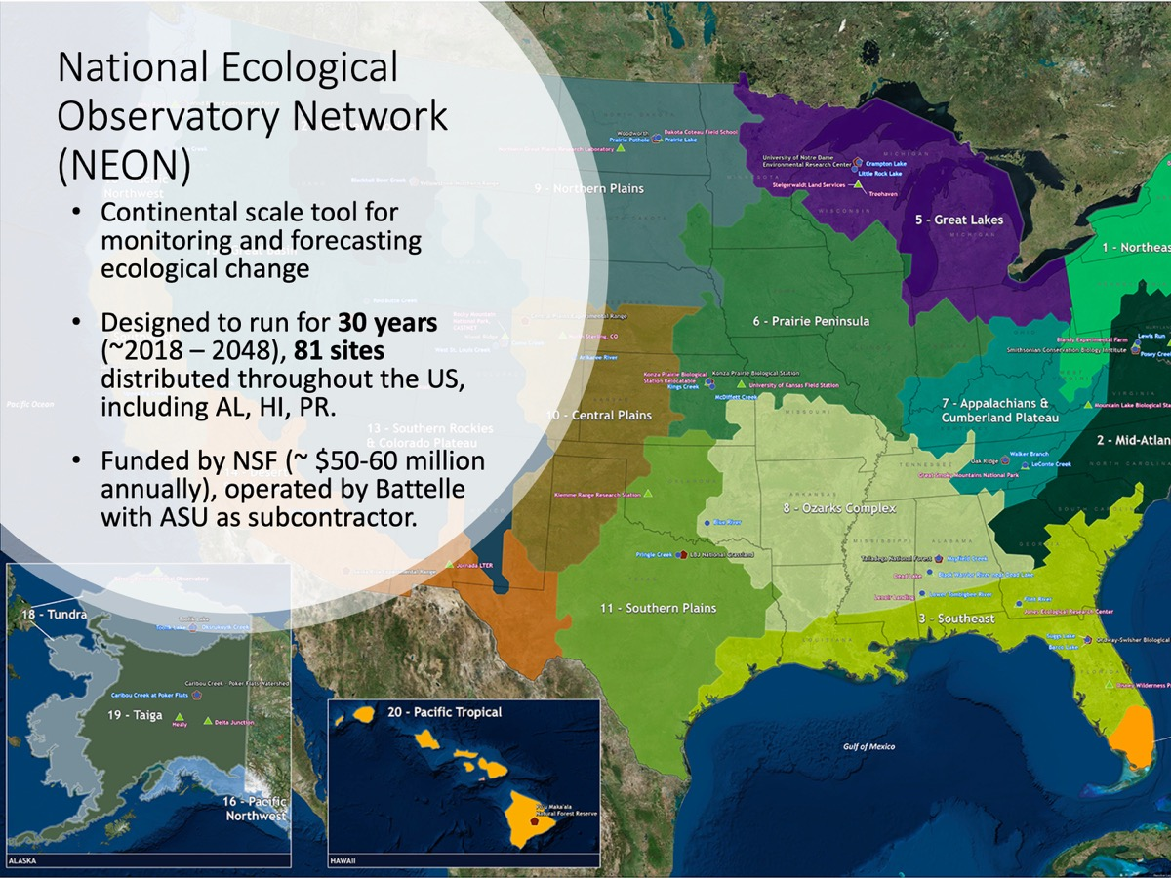
Introducing the NEON Biorepository Data Portal

Slide 8
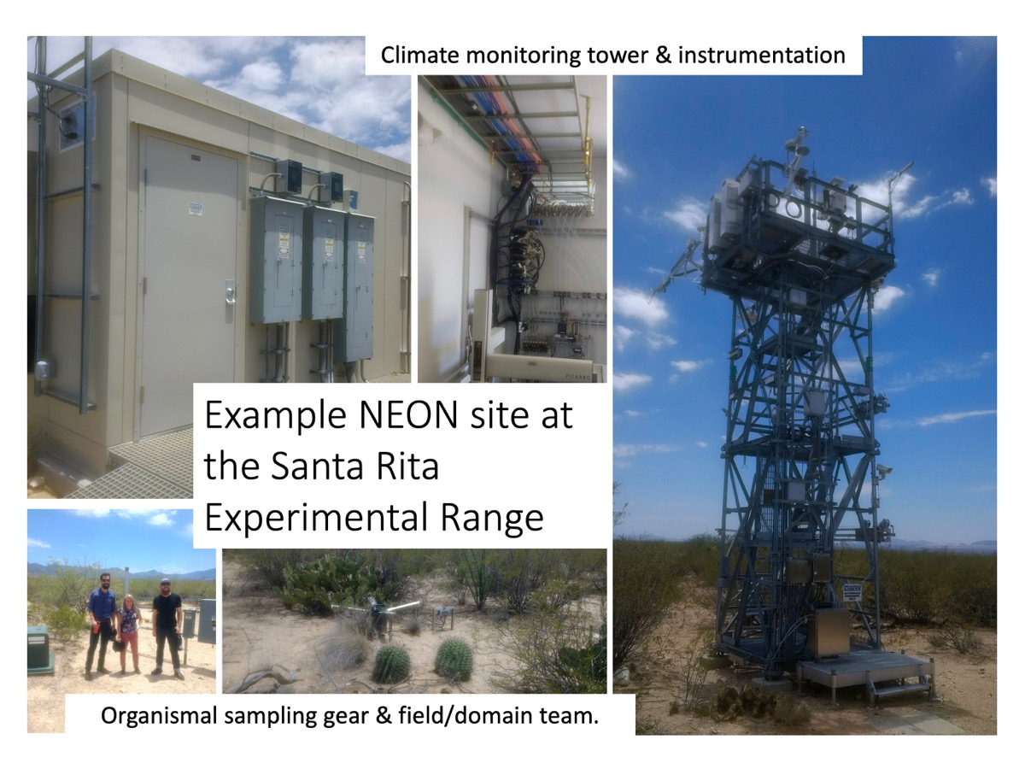
Introducing the NEON Biorepository Data Portal

Slide 9
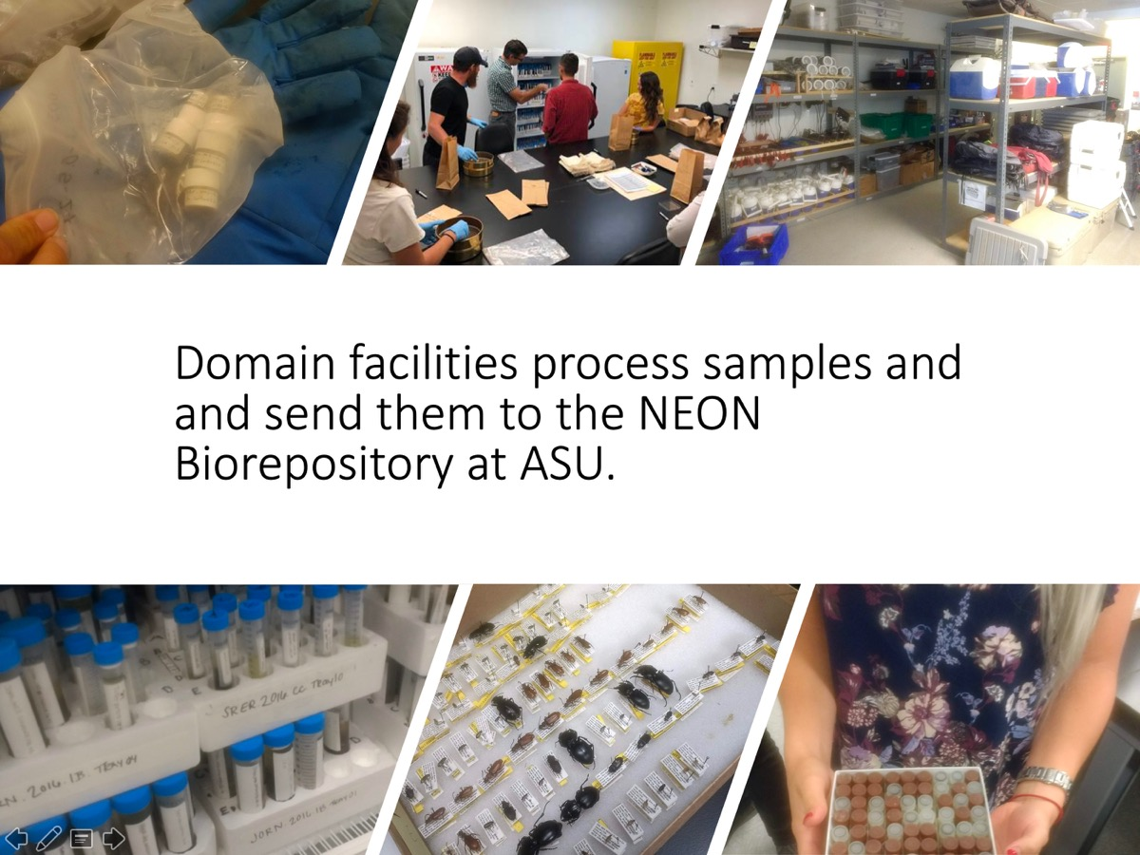
Introducing the NEON Biorepository Data Portal

Slide 10
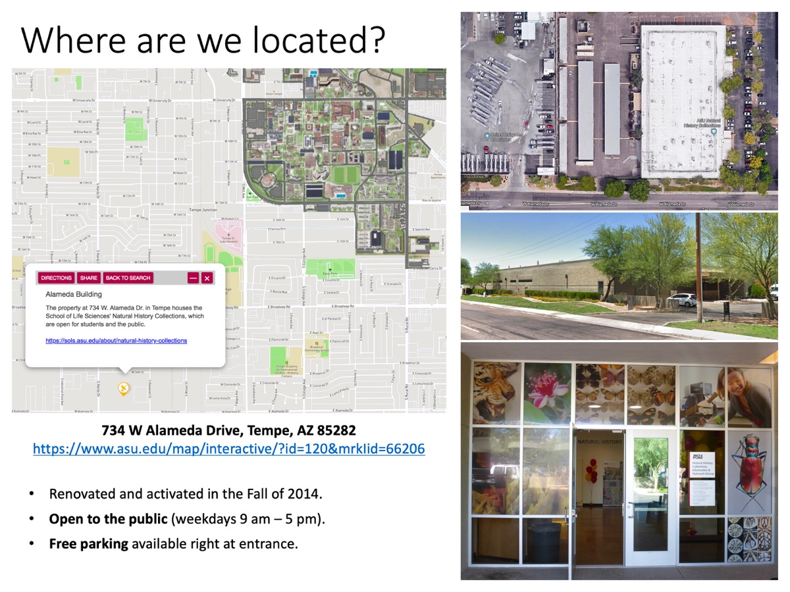
Introducing the NEON Biorepository Data Portal

Slide 11
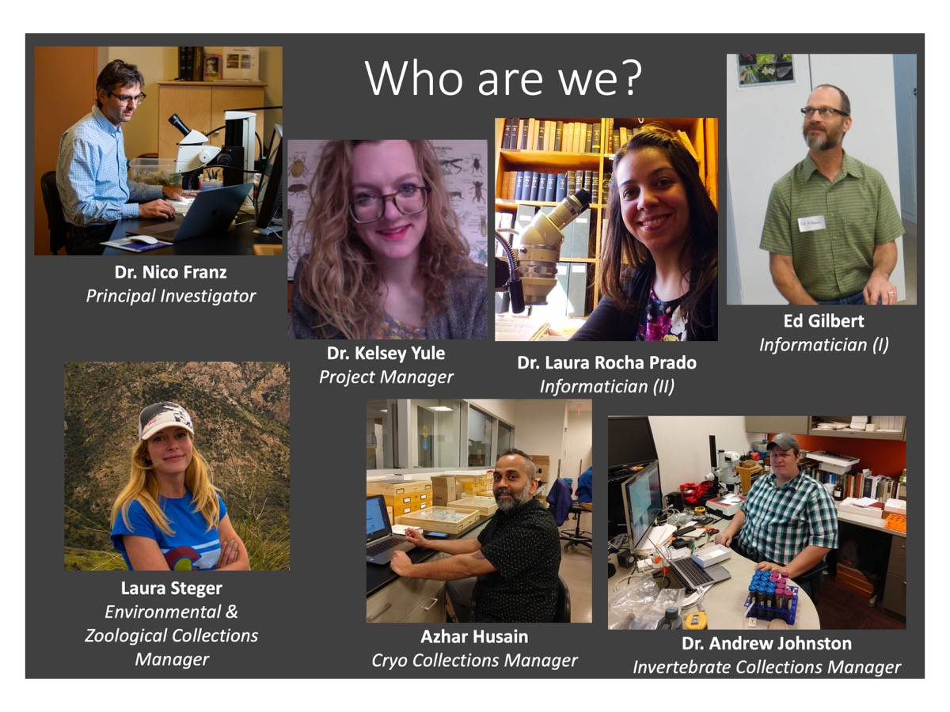
Introducing the NEON Biorepository Data Portal

Slide 12
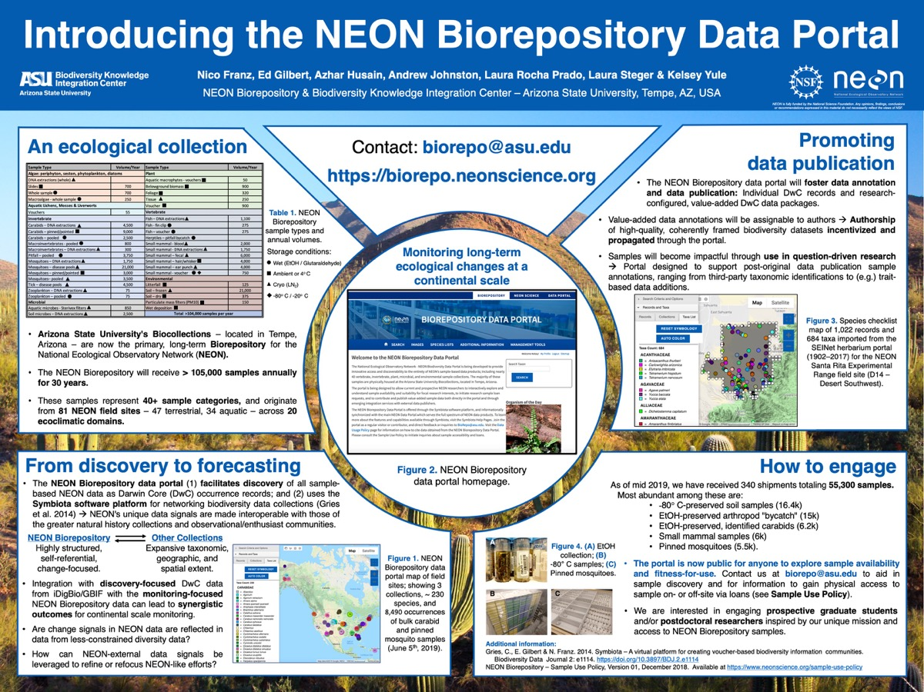
More information at Tuesday's poster session!
Using the portal
Access to samples
New developments
Informatics
Research
Prospective M.Sc./ Ph.D. applicants and postdocs
Early and broad-based use is key!

Slide 13
A short demonstration
https://biorepo.neonscience.org

Slide 14
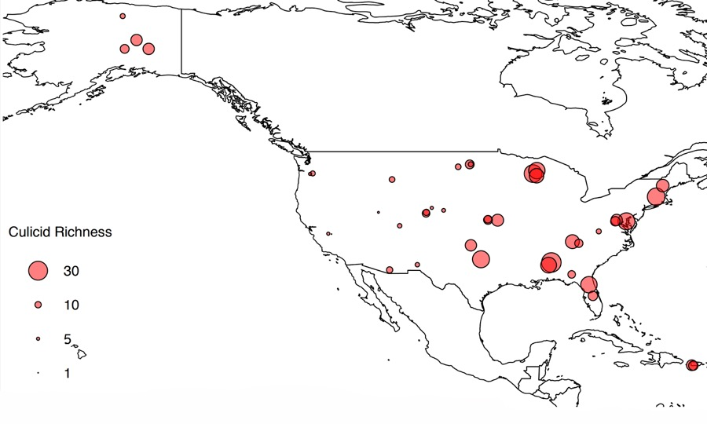
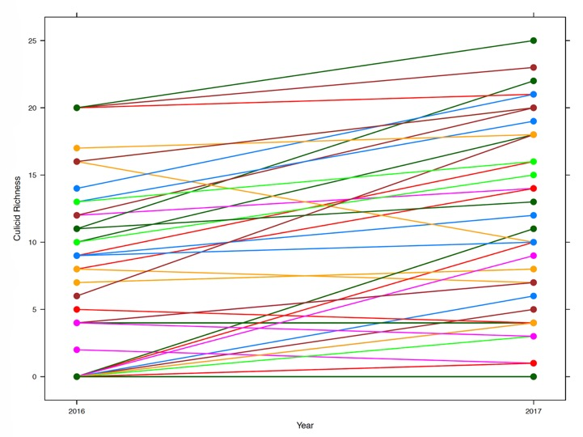
[after a short BioRepo portal demo (Culicidae / SRER Plants)] *
Mosquito species richness per site, 2016–2017.
Change in species richness per site.
NEON organismal sampling produces a unique, taxon-/region-/time-constrained, change-focused data signal.
* Thanks to Dr. Kelsey Yule, NEON Biorepository @ ASU.

Slide 15
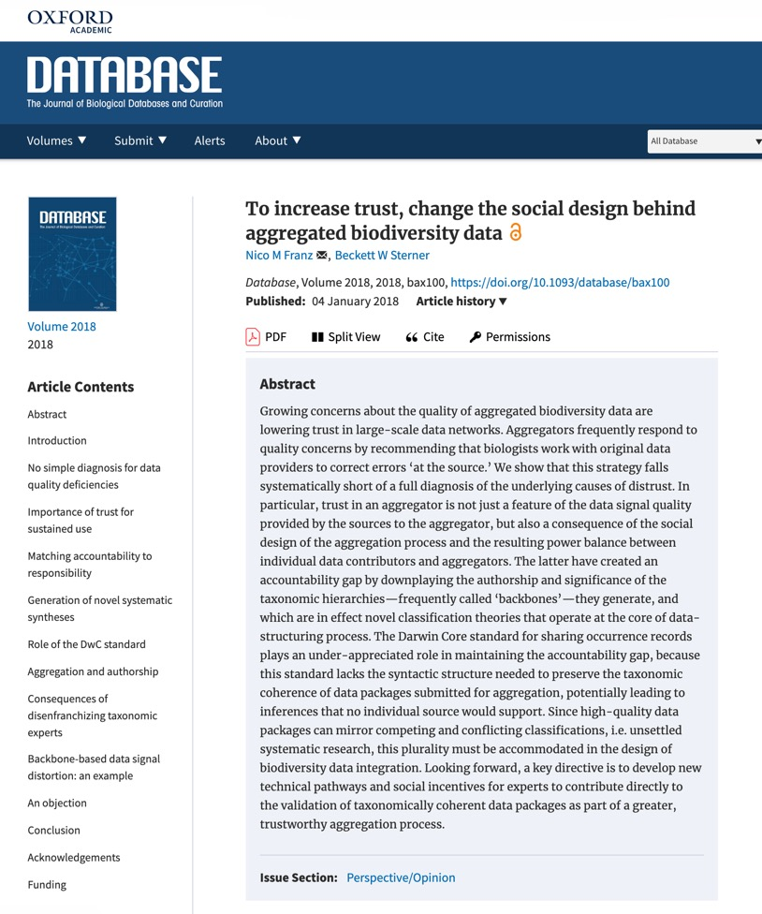
Rethinking centralized biodiversity data aggregation (2)
https://doi.org/10.1093/database/bax100
Critique of monolithic aggregation designs.

Slide 16
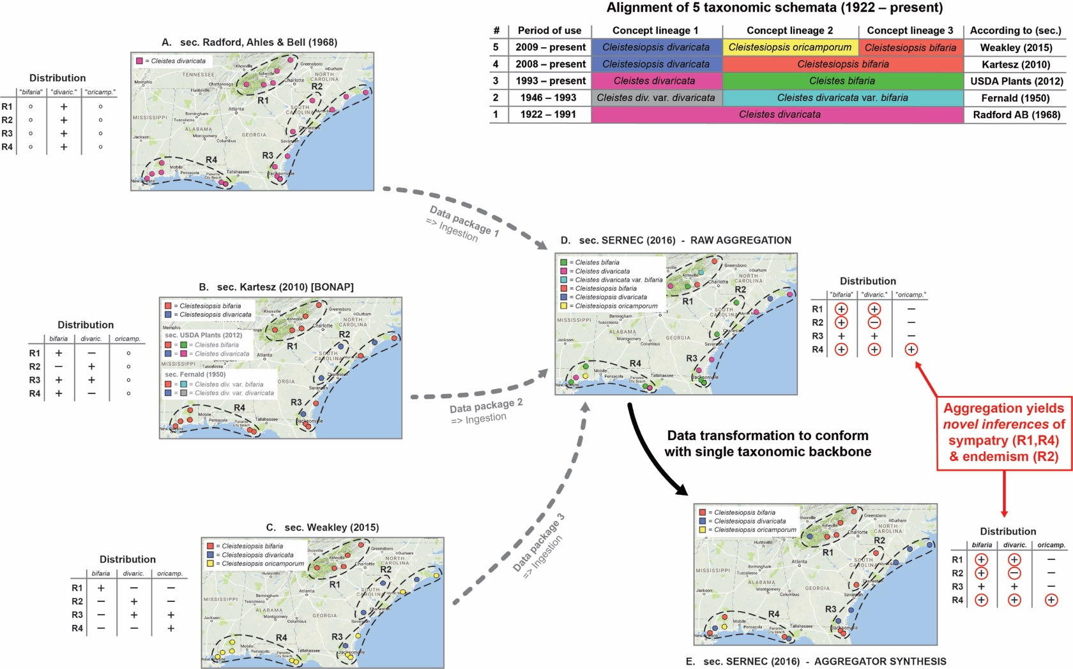

Slide 17
Rethinking centralized biodiversity data aggregation (2)
https://doi.org/10.1093/database/bax100
Critique of monolithic aggregation designs.
Here we reformulate the issue in relation to the direction of data flow in hierarchical biodiversity data aggregation networks.

Slide 18
Rethinking centralized biodiversity data aggregation (2)
https://doi.org/10.1093/database/bax100
Critique of monolithic aggregation designs.
Here we reformulate the issue in relation to the direction of data flow in hierarchical biodiversity data aggregation networks.
Then we outline a complementary solution that is not centralized, yet which can potentially reach global coverage.

Slide 19
Rethinking centralized biodiversity data aggregation (2)
https://doi.org/10.1093/database/bax100
Critique of monolithic aggregation designs.
Here we reformulate the issue in relation to the direction of data flow in hierarchical biodiversity data aggregation networks.
Then we outline a complementary solution that is not centralized, yet which can potentially reach global coverage.
This solution is being developed at ASU under the project name "BioCache".

Slide 20

Centralized biodiversity data aggregation
Many collections remain offline.

Slide 21
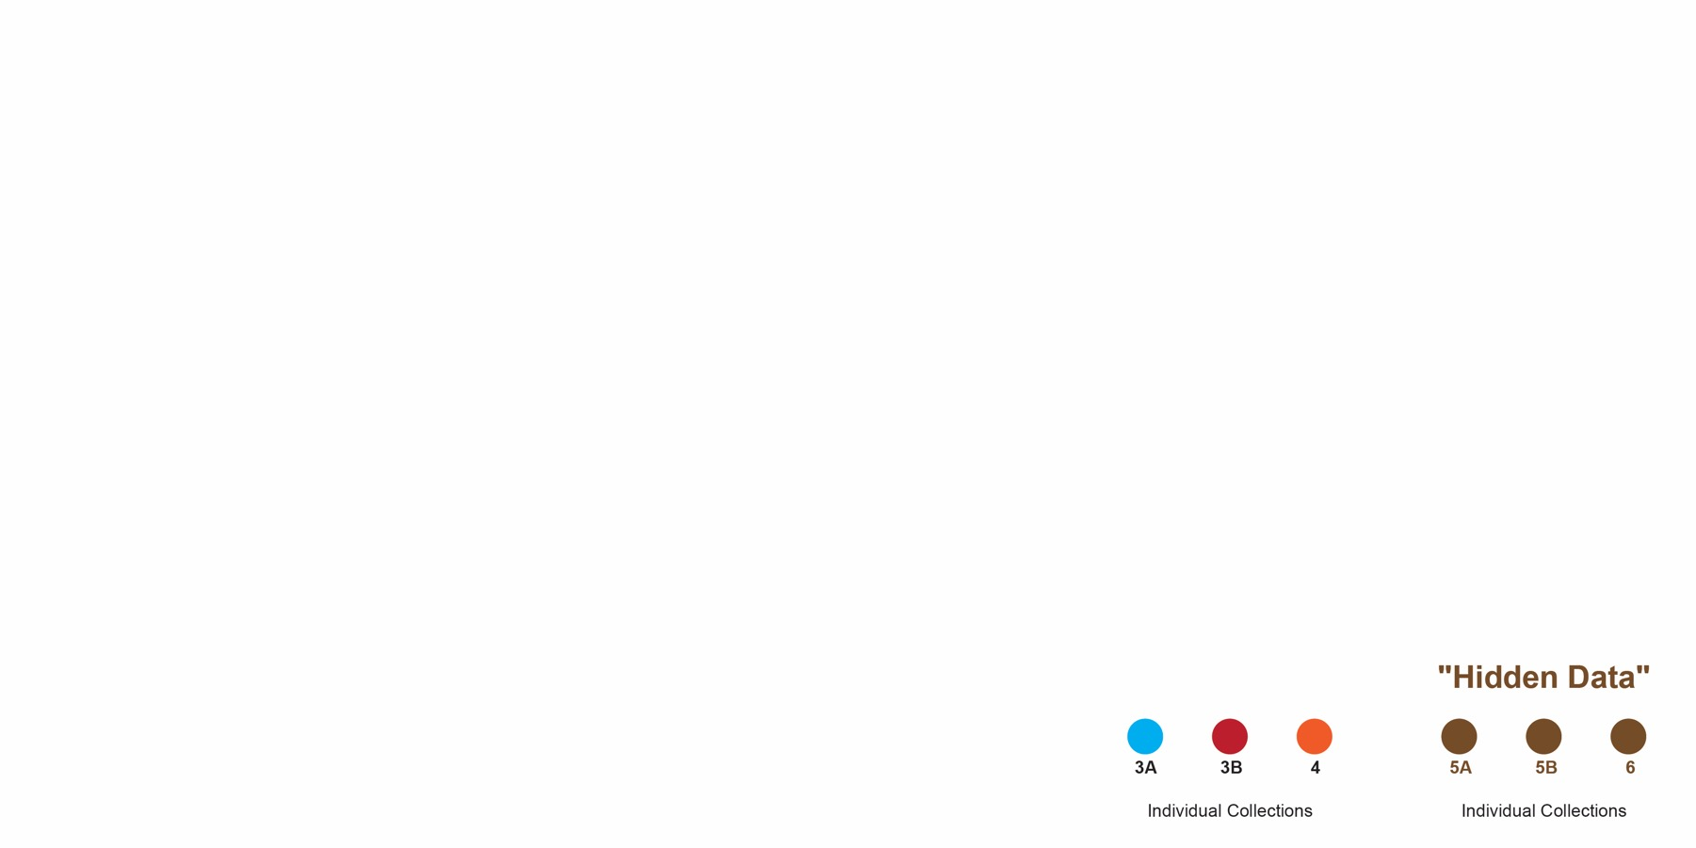
Centralized biodiversity data aggregation
Other, individual collections, may have a web presence.

Slide 22
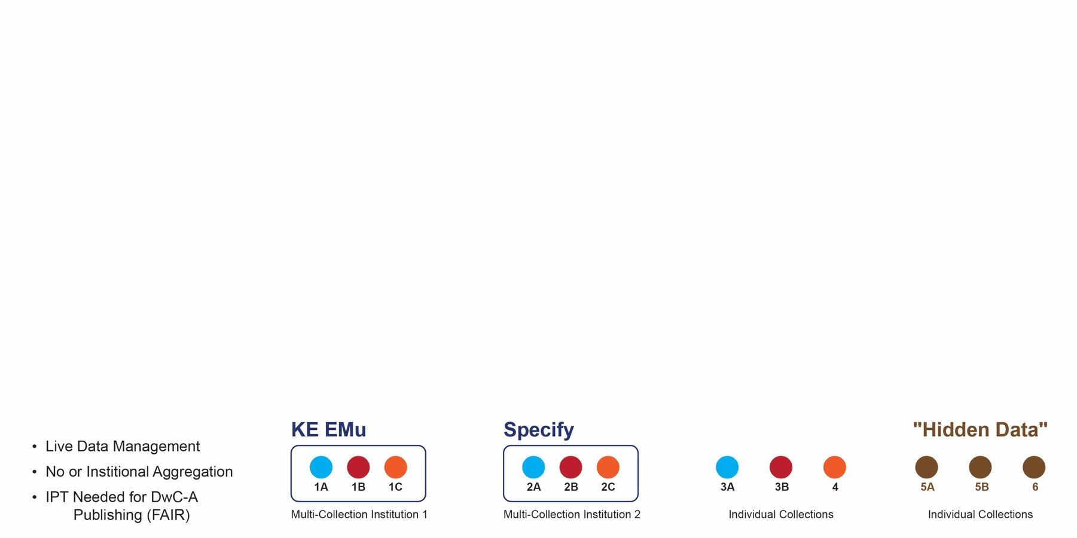
Centralized biodiversity data aggregation
Multi-collections software applications can bring institutional datasets on-line; yet this alone may not suffice to publish DwC-Archive data according to FAIR standards.

Slide 23
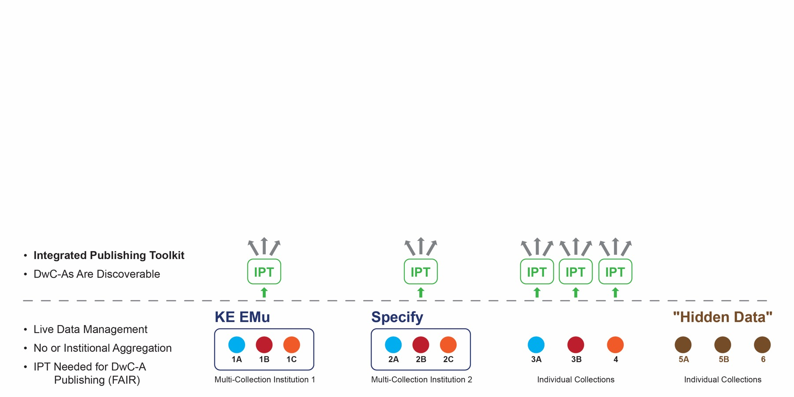
Centralized biodiversity data aggregation
The Integrated Publishing Toolkit (IPT) allows individual or multi-collection datasets to become discoverable as DwC-Archive packages to higher-level aggregators.

Slide 24
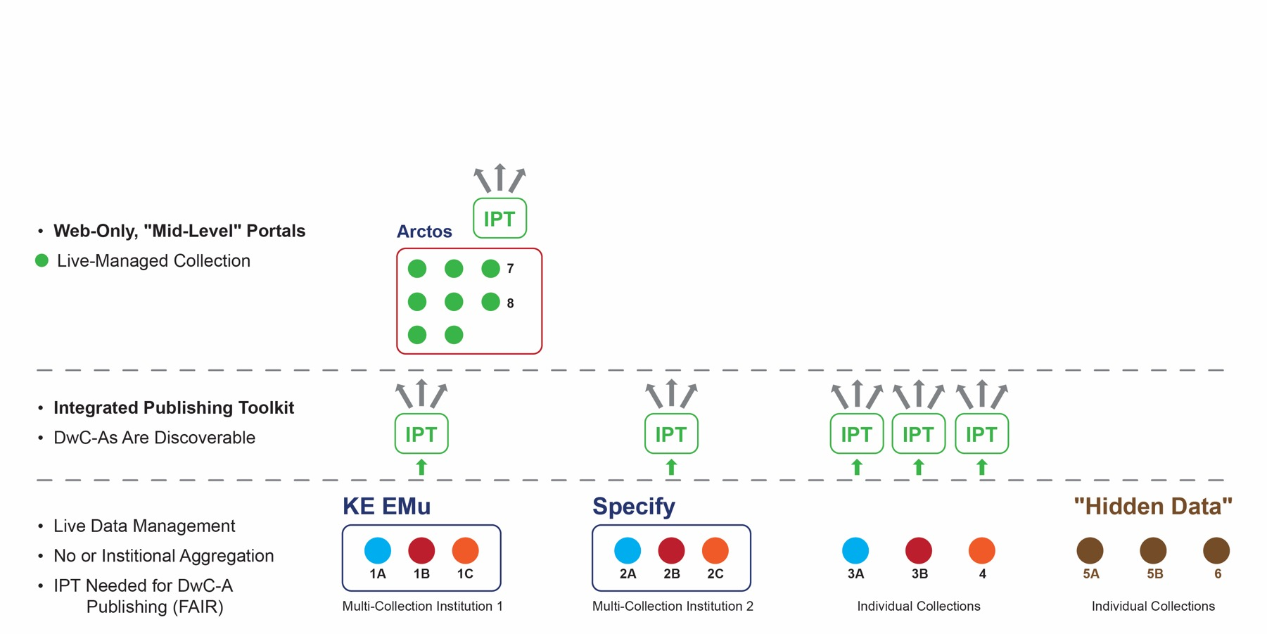
Centralized biodiversity data aggregation
There are also web-only, mid-level portal applications that support live collection management and can publish "up" through the (IPT).

Slide 25
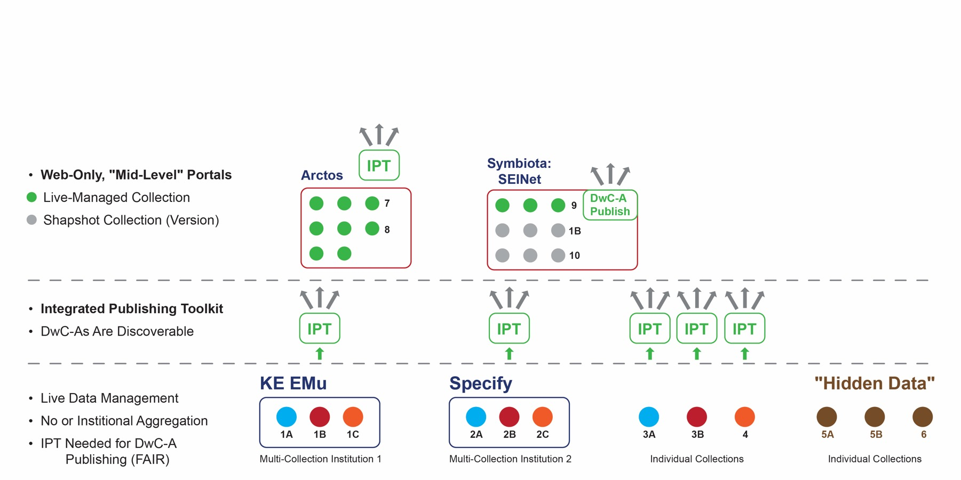
Centralized biodiversity data aggregation
Symbiota portals also support "snapshot collections" – i.e., periodical, manually triggered batch re-/uploads of static versions that are live-managed elsewhere.

Slide 26
Centralized biodiversity data aggregation
Symbiota portals also have a custom, fully built-in, IPT-analogous "Darwin Core Archive Publishing" module.

Slide 27
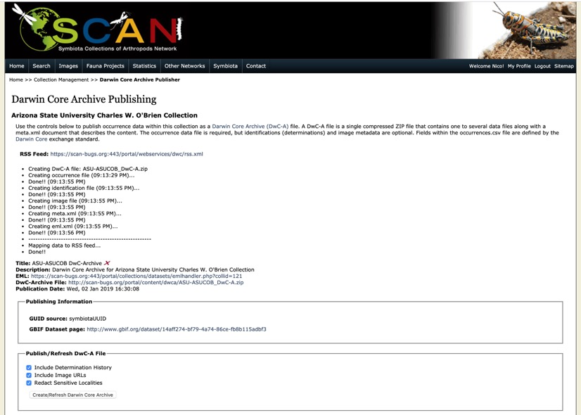
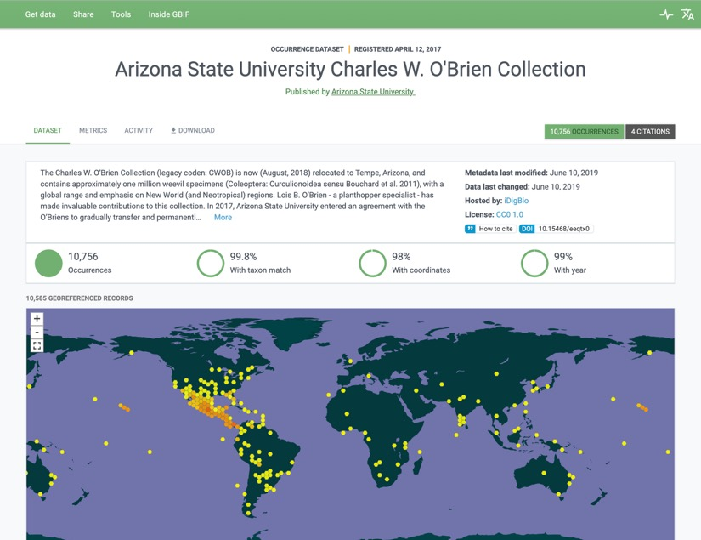
Example of Symbiota's DwC-A Publishing module (SCAN: ASUCOB)
June 10, 2019

Slide 28
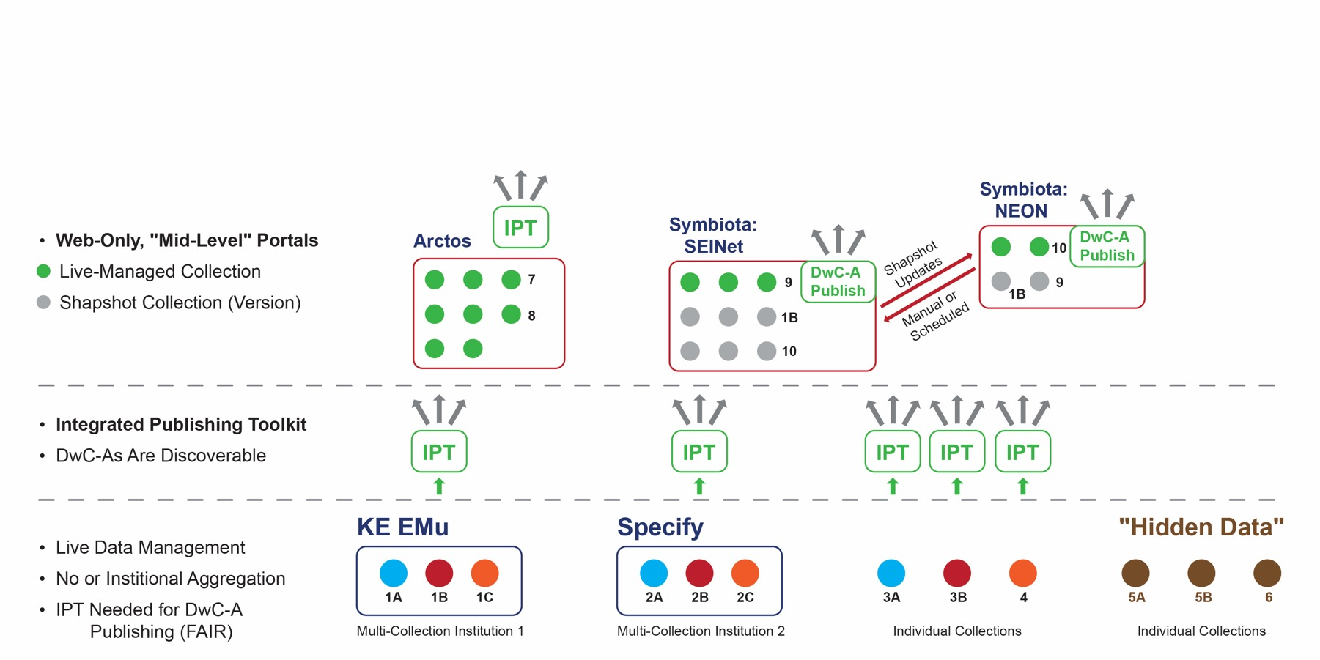
Centralized biodiversity data aggregation
Multiple, community-themed portals – each with unique live/snapshot collection profiles – can periodically receive reciprocal snapshot updates.

Slide 29
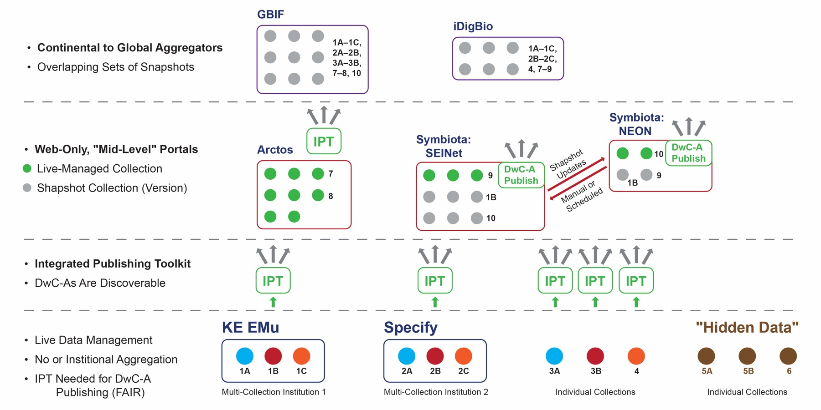
Highest-level aggregators typically only support collection snapshots!

Slide 30
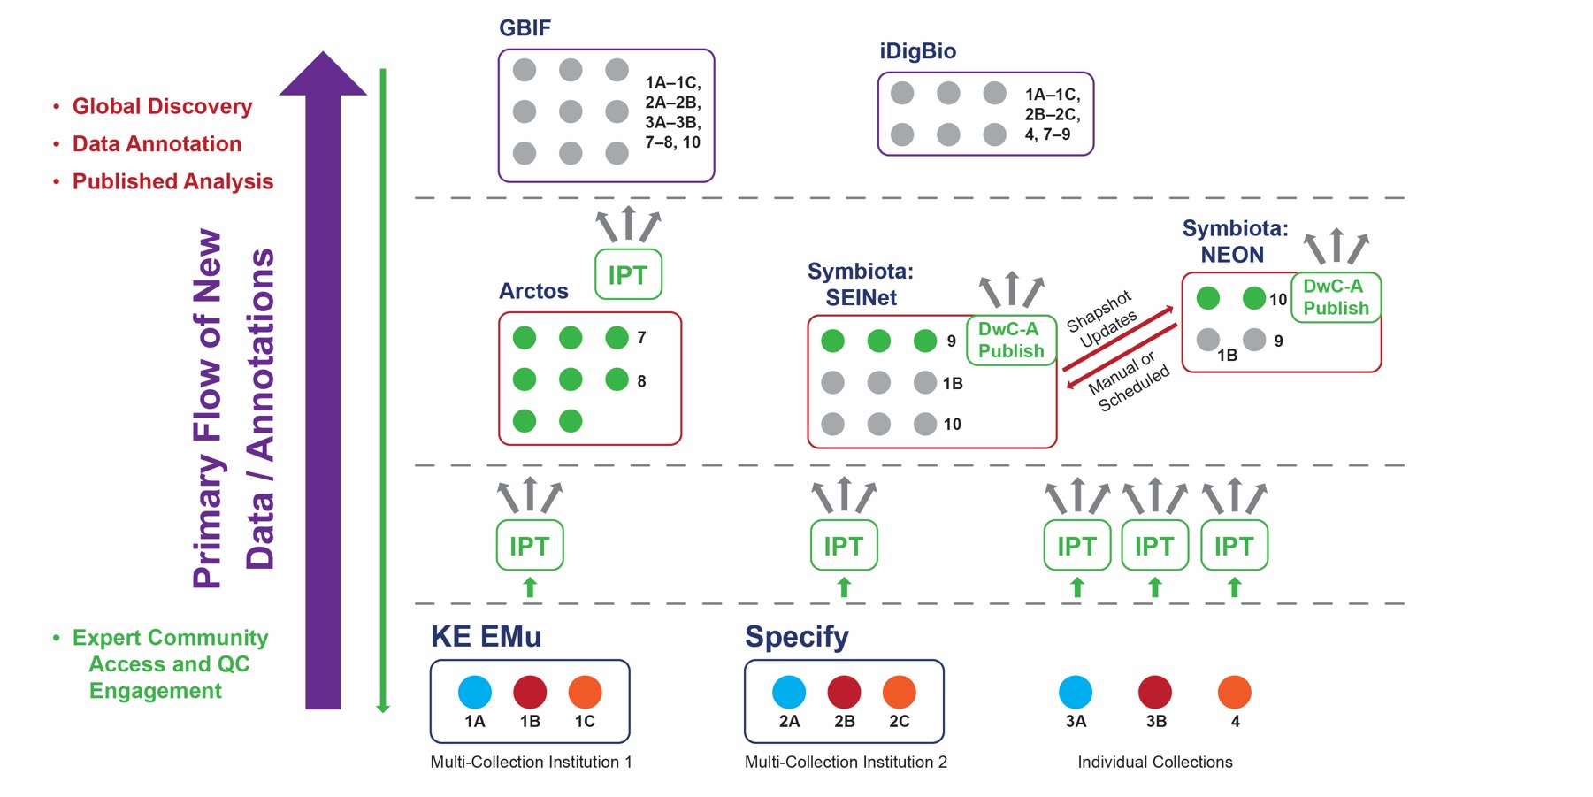
This hierarchy sustains an imbalance in directional data flow:
Annotations on global datasets are hard to pull downwards.

Slide 31
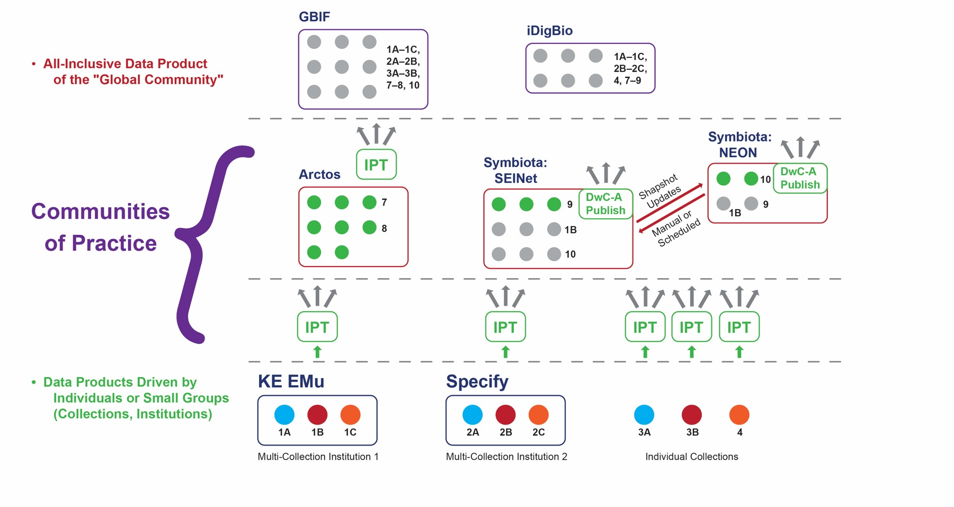
Moreover, by the time we reach the top, most experts/enthusiasts
no longer feel at home (cf. Wenger 2000).

Slide 32
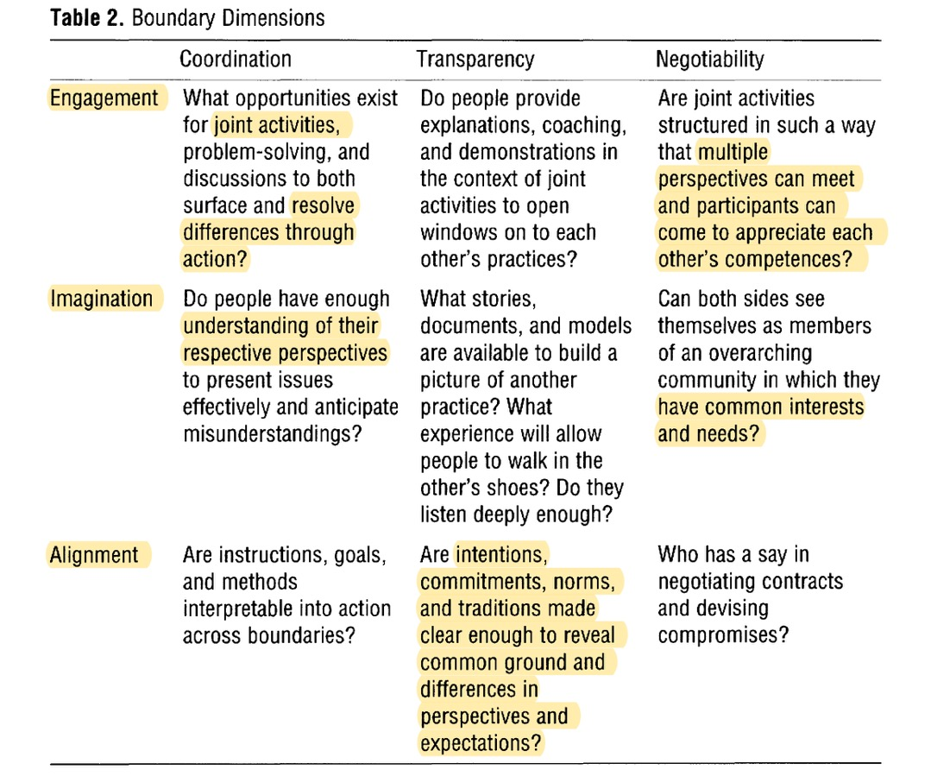
Wenger 2000: Communities of practice and social learning systems

Slide 33
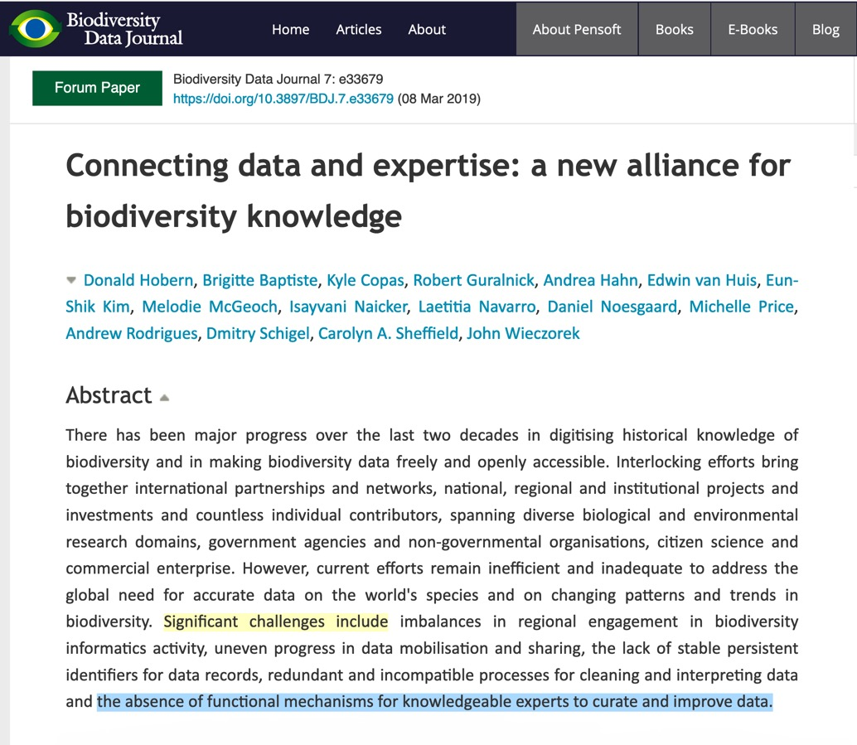
Community Access ⬄ Engagement ⬄ Quality ⬄ Trust ⬄ Use & Impact

Slide 34
Designing for strong data communities

Slide 35
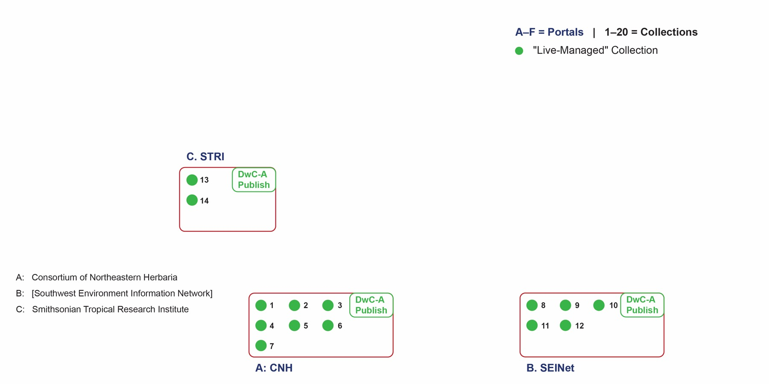
De-centralized, but global
Independent, themed portal communities maintain live-managed collections.

Slide 36
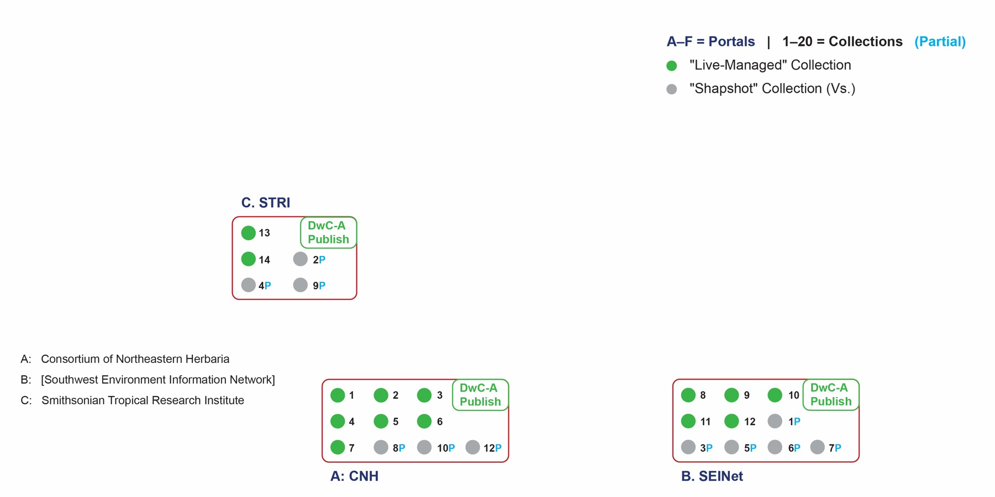
De-centralized, but global
Partial, relevant collection snapshot subsets are represented.

Slide 37
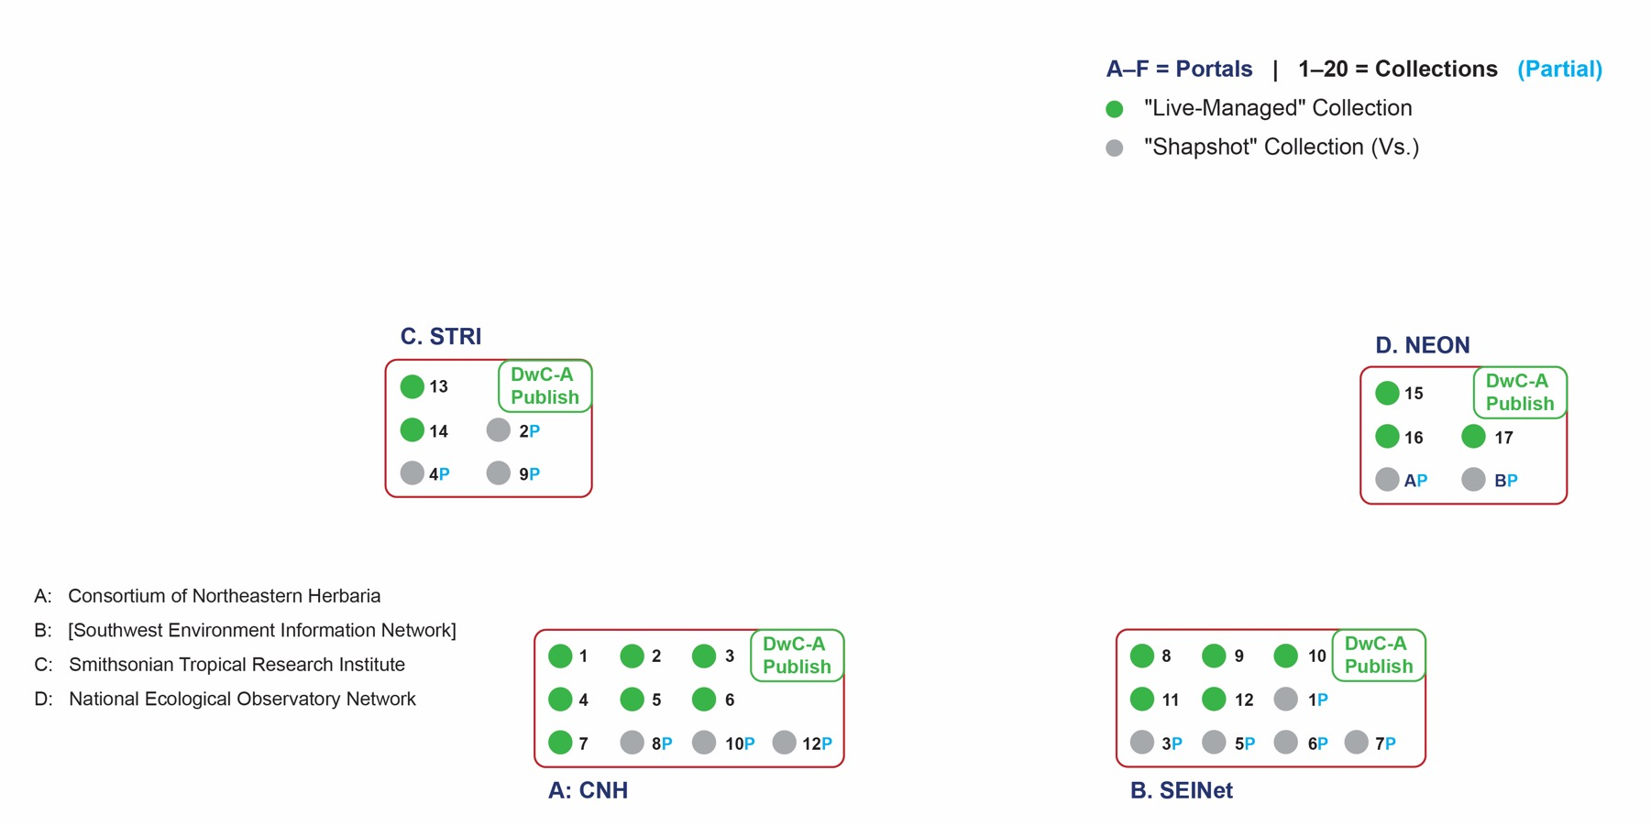
De-centralized, but global
Even partial, relevant portal snapshot subsets are ingestible, with provenance.

Slide 38
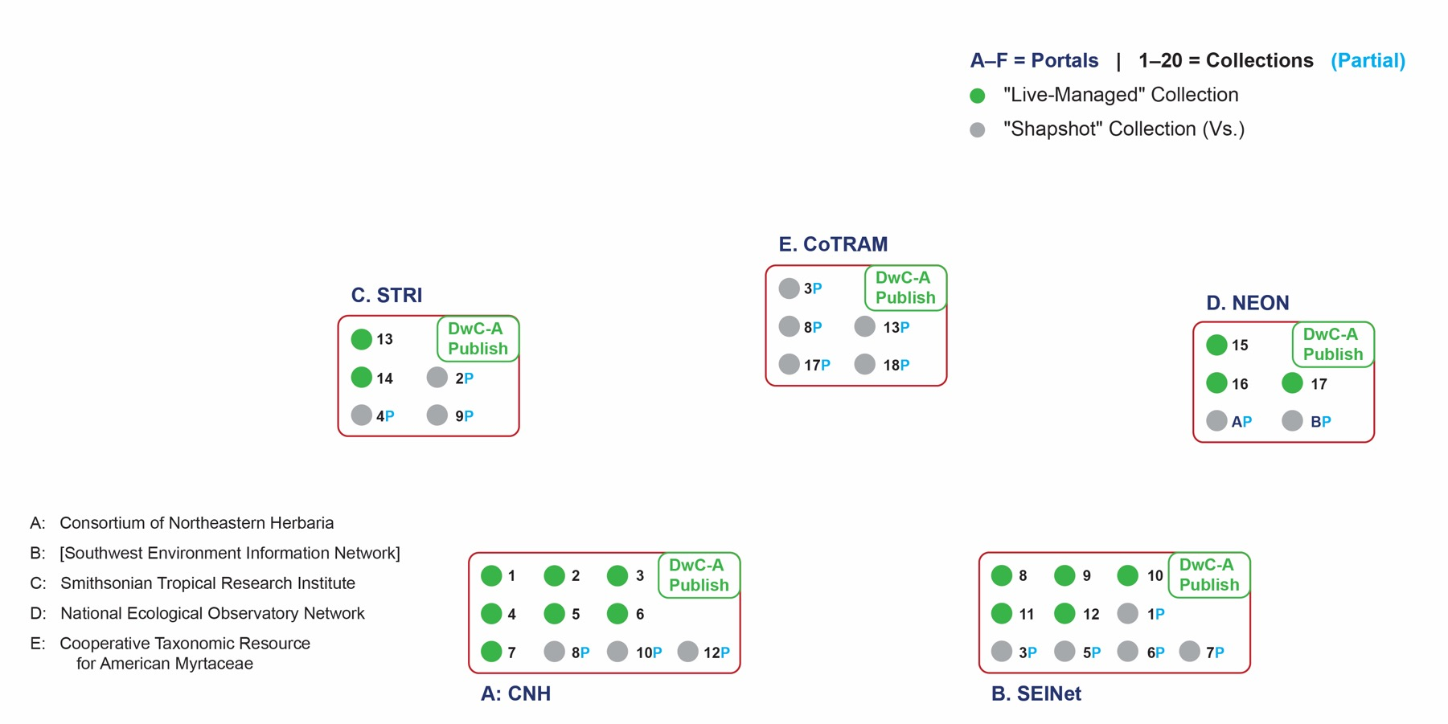
De-centralized, but global
Some research-themed portals may only include partial collection snapshots.

Slide 39
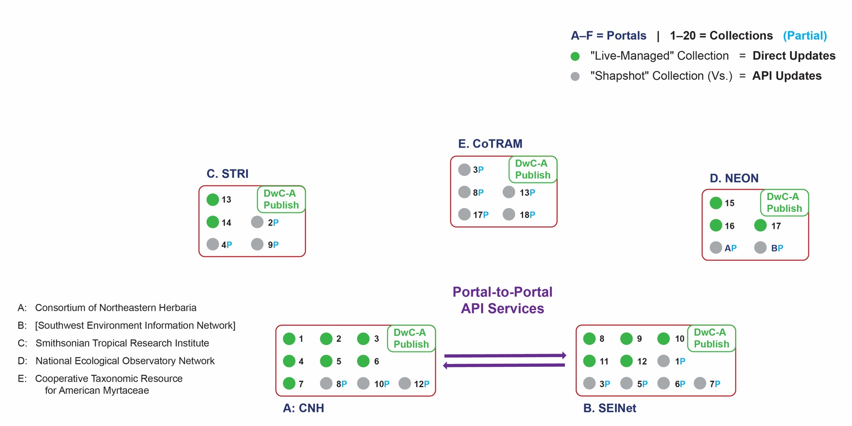
De-centralized, but global
Highly configurable portal-to-portal APIs negotiate the flow of data between live and snapshot collection instances.

Slide 40
De-centralized, but global
As API services are optimized, the distinction between live and snapshot collection management increasingly falls away.

Slide 41
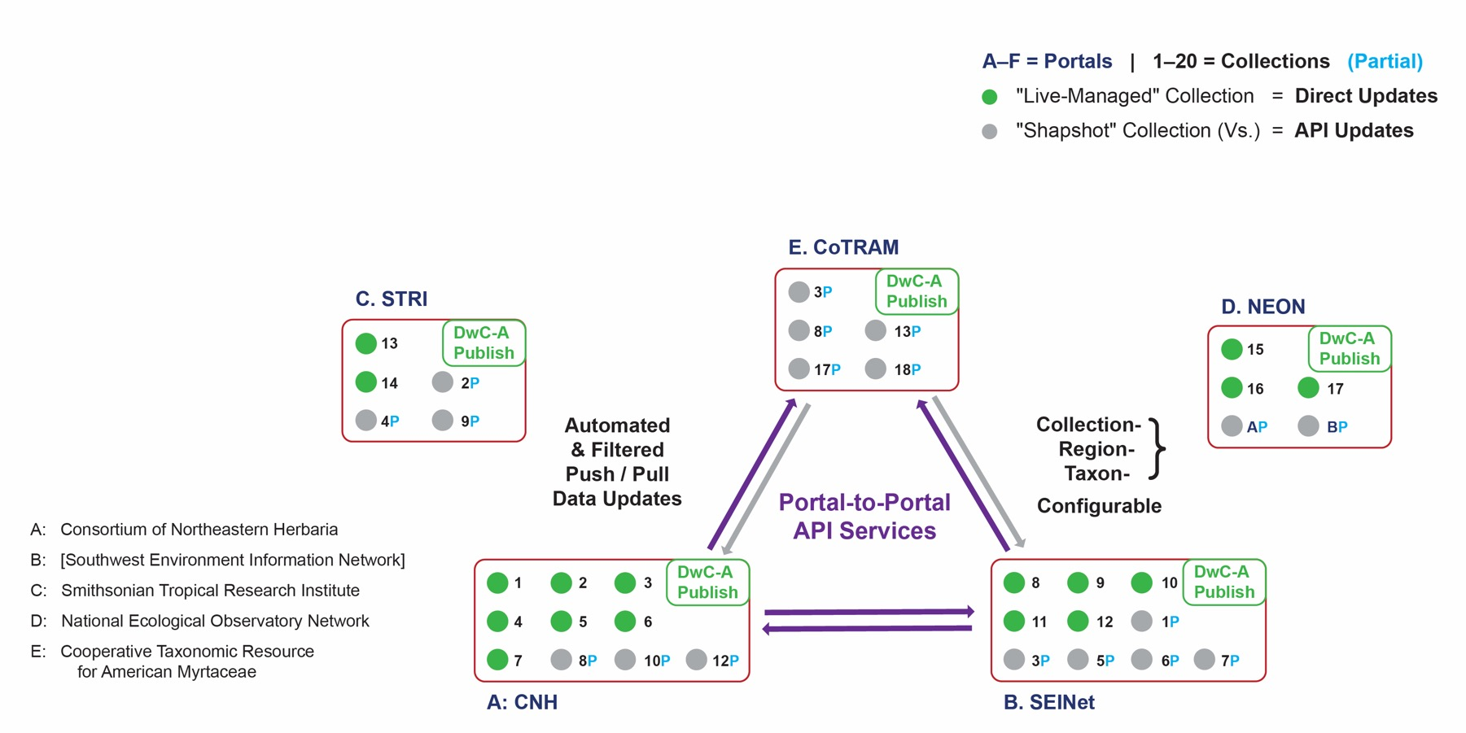
De-centralized, but global
API service configurations include filtered, source-/sink-approval contingent data pushes and pulls.

Slide 42
De-centralized, but global
API service configurations allow filtered {collection, taxon, region, etc.), source-/sink-approval contingent data pushes and pulls.

Slide 43
De-centralized, but global
Portal-to-portal API configurations become the "substrate" upon which the communities realize their "modes of belonging".

Slide 44
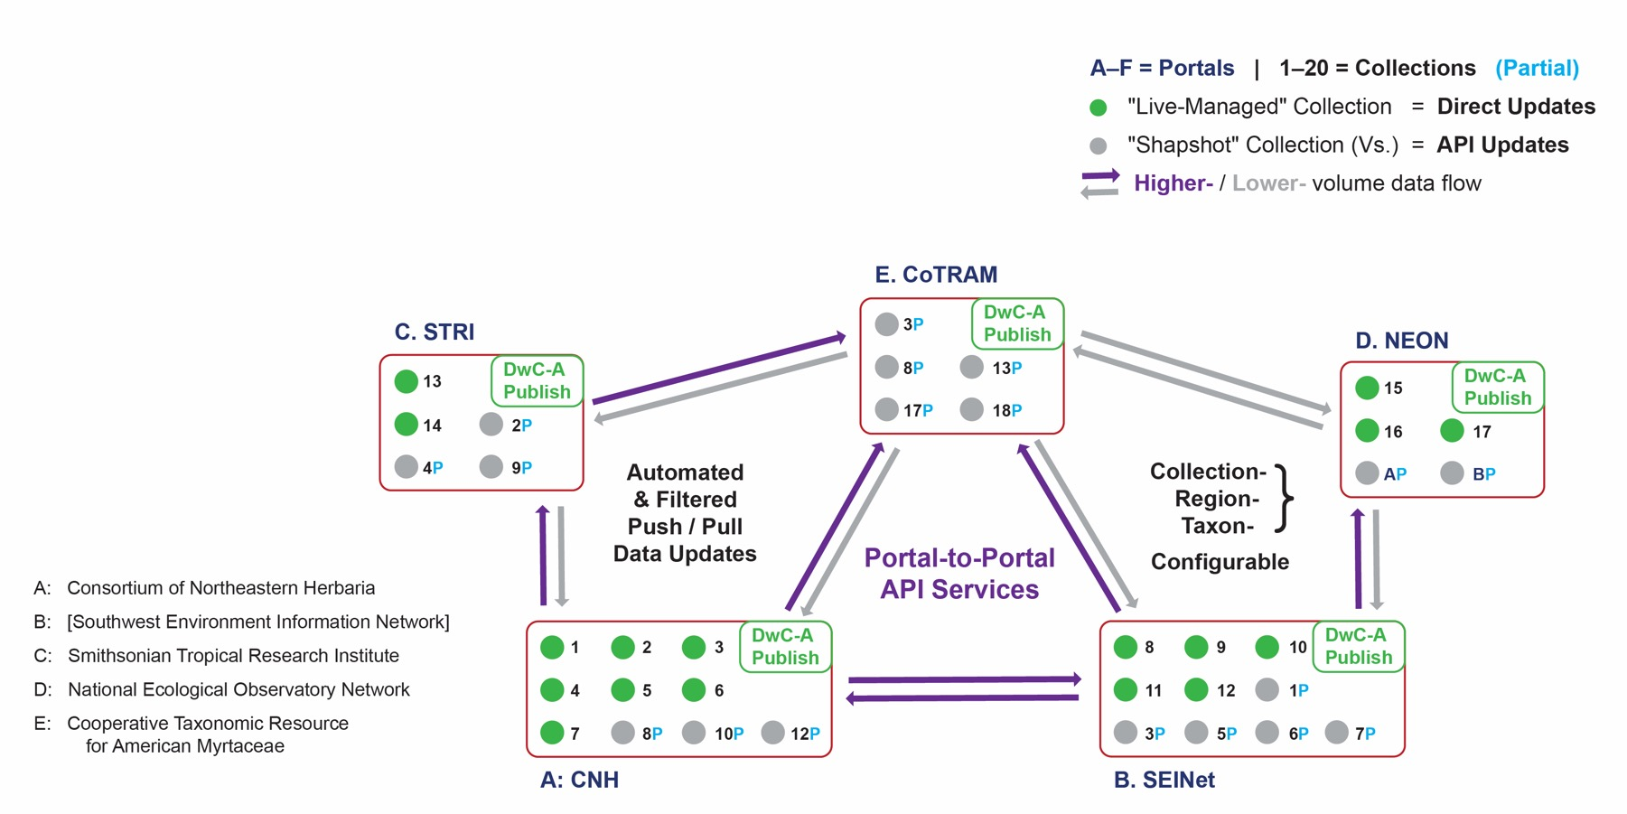
De-centralized, but global
The de-centralized network is broadly extensible between closely (high data flow) or remotely (low data flow) related communities.

Slide 45
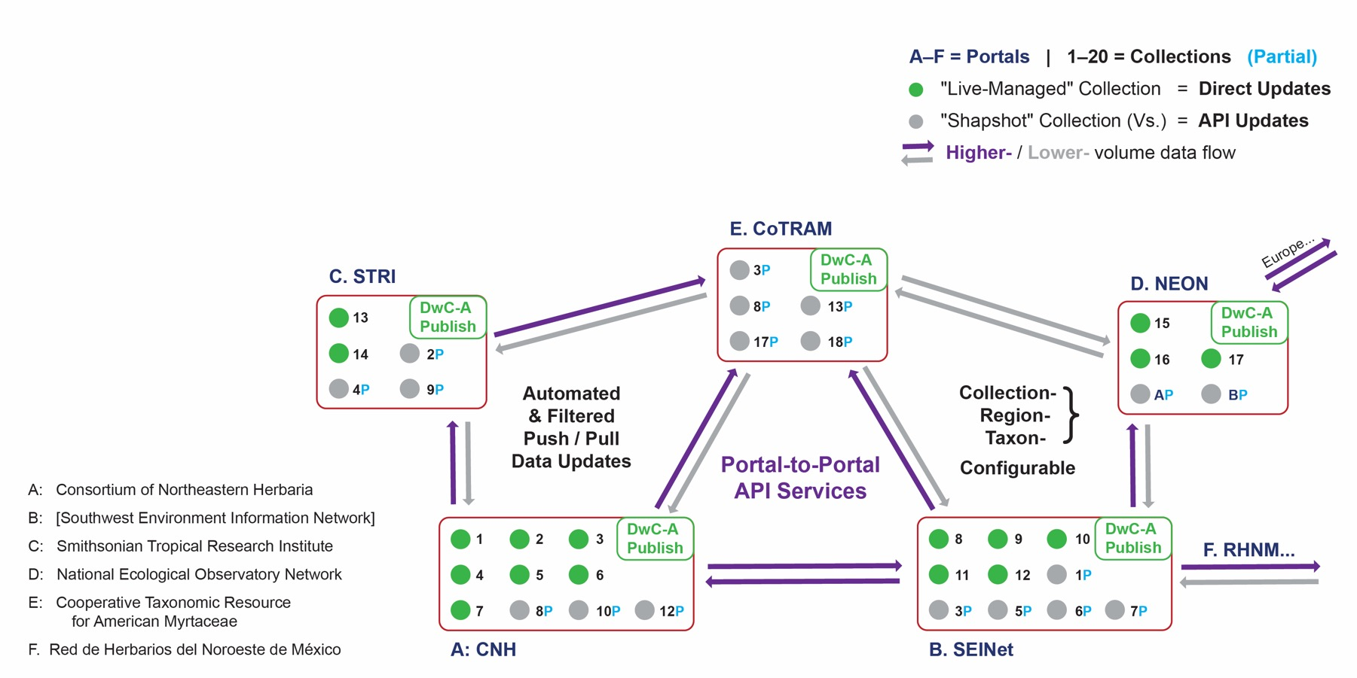
De-centralized, but global
On the basis of a shared API service culture, a de-centralized data portal network can potentially grow to attain global coverage.

Slide 46
Designing for expert/enthusiast access

Slide 47
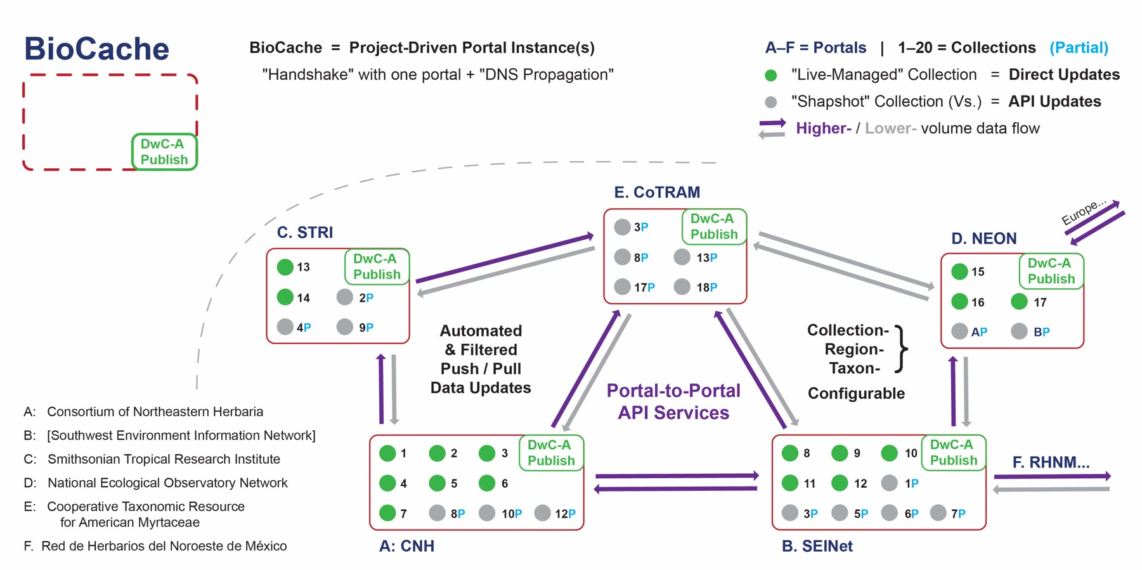
BioCache: Global access through custom research portal instances
Researchers create and register "via single handshake" a new portal instance.

Slide 48
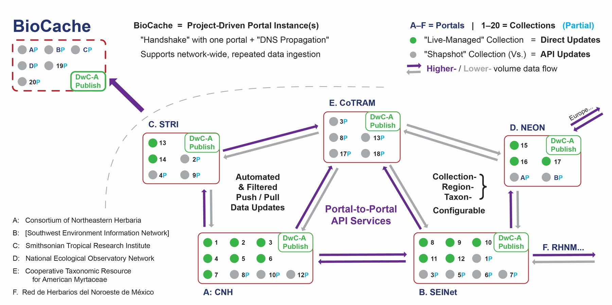
BioCache: Global access through custom research portal instances
Research instances enable repeatable, global data queries and re-/ingestion.

Slide 49
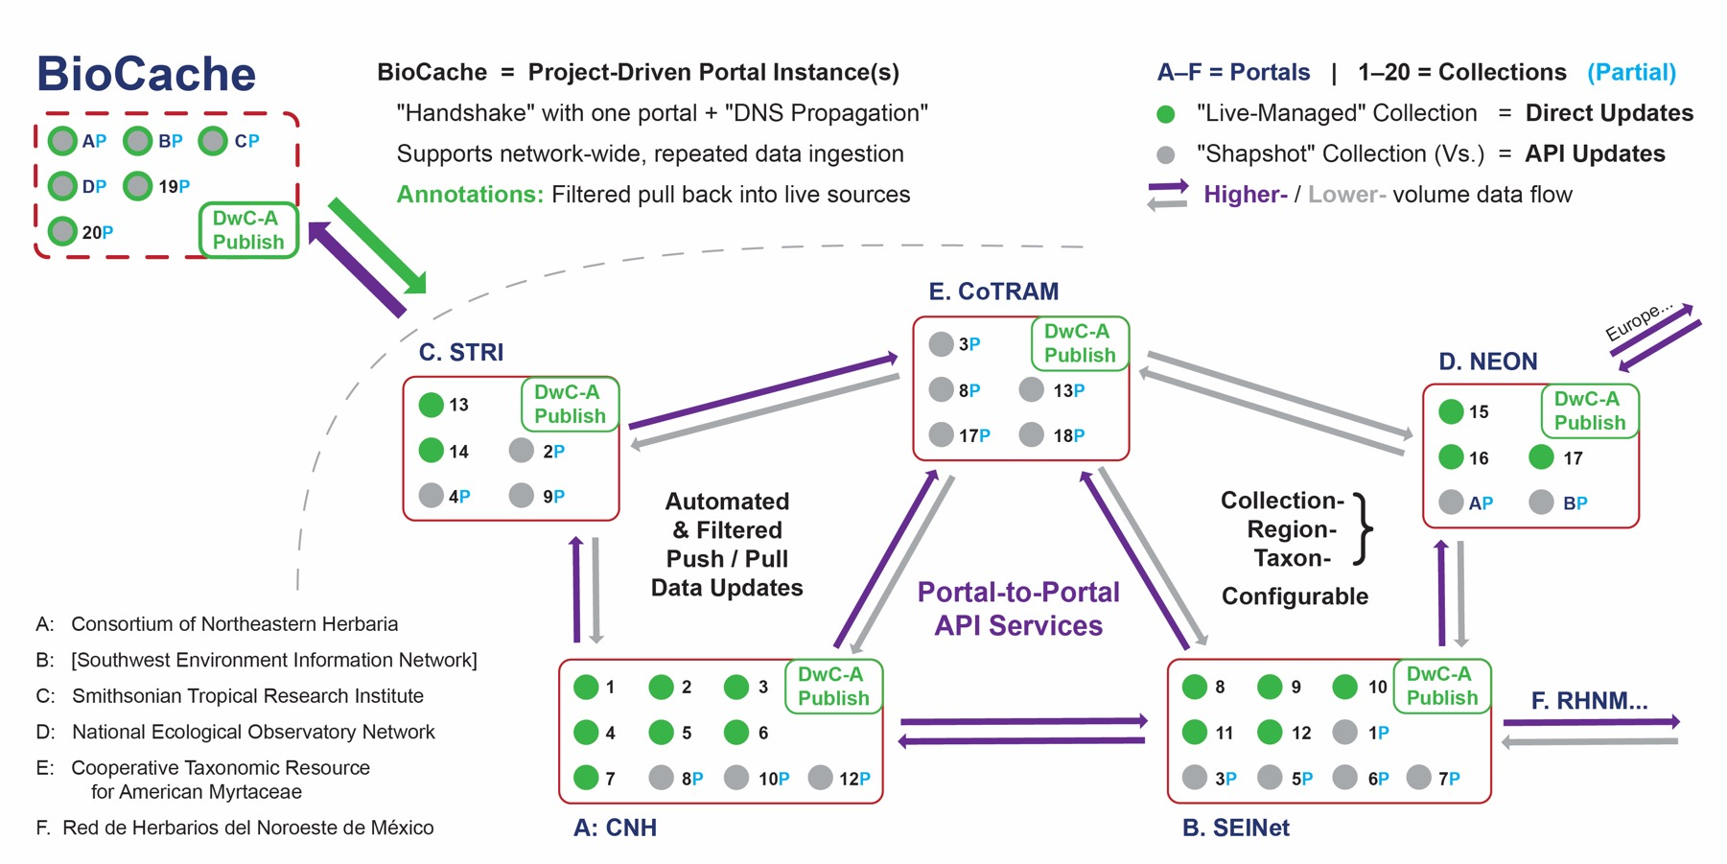
BioCache: Global access through custom research portal instances
Valued-added data can return to all (live) source collections via filtered pulls.

Slide 50
Stay tuned, it's underway

Slide 51
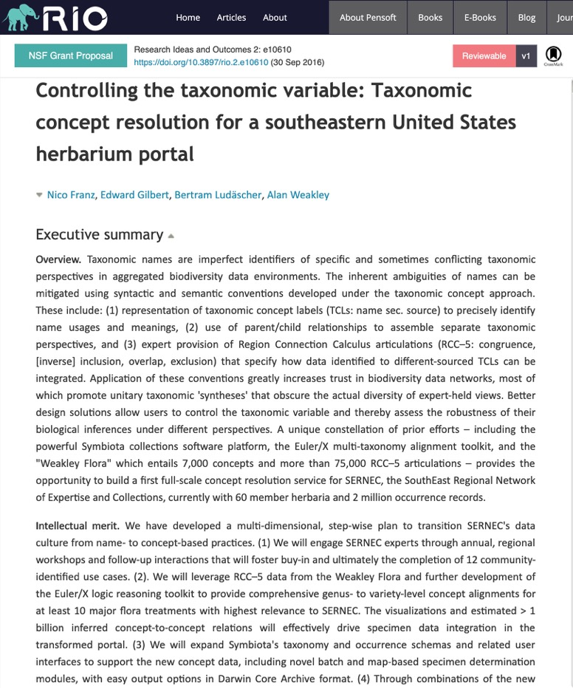
Taxonomic data intelligence for Darwin Core occurrences (3)
https://doi.org/10.3897/rio.2.e10610
Engaging expert/enthusiast communities ⬄ need for pluralism and democracy for and among taxonomic perspectives in biodiversity data aggregation designs.

Slide 52
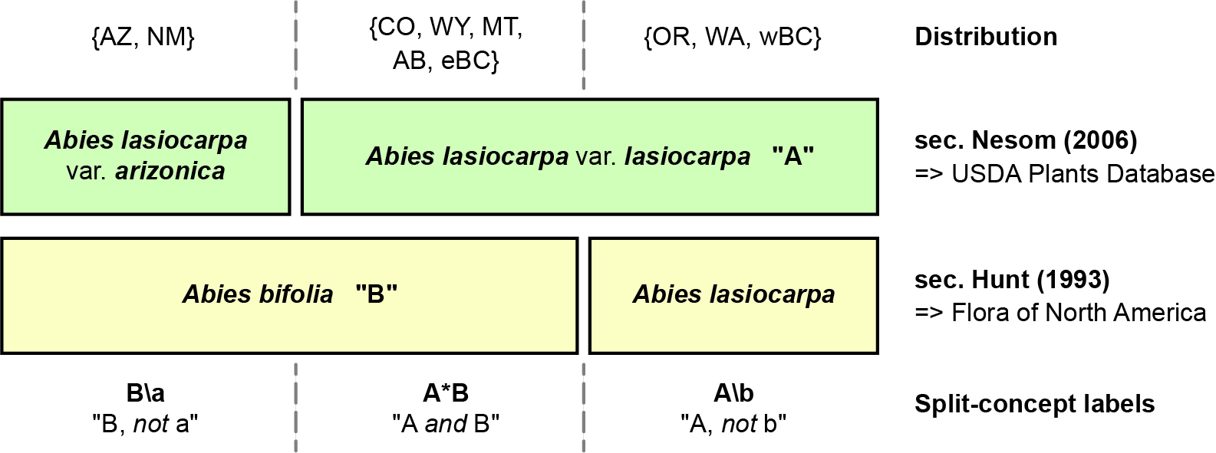
Alignment by Alan Weakley (http://herbarium.unc.edu/flora.htm)

Slide 53
Taxonomic data intelligence for Darwin Core occurrences (3)
https://doi.org/10.3897/rio.2.e10610
Engaging expert/enthusiast communities ⬄ need for pluralism and democracy for and among taxonomic perspectives in biodiversity data aggregation designs.
Spatial reasoning tools (RCC–5) can help attain consistent and comprehensive taxonomic meaning mappings ⬄ intelligence for data integration across evolving or conflicting views.

Slide 54
Taxonomic data intelligence for Darwin Core occurrences (3)
https://doi.org/10.3897/rio.2.e10610
Engaging expert/enthusiast communities ⬄ need for pluralism and democracy for and among taxonomic perspectives in biodiversity data aggregation designs.
Spatial reasoning tools (RCC–5) can help attain consistent and comprehensive taxonomic meaning mappings ⬄ intelligence for data integration across evolving or conflicting views.
Biological inferences become robust, in relation to "the taxonomic variable".

Slide 55
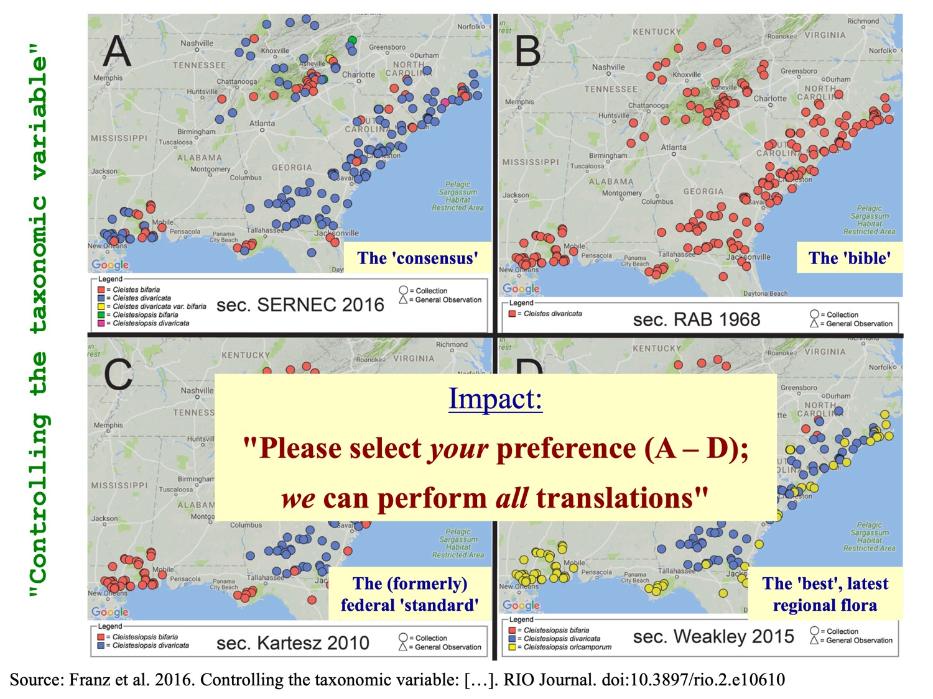

Slide 56
Project remains pending, but look!

Slide 57
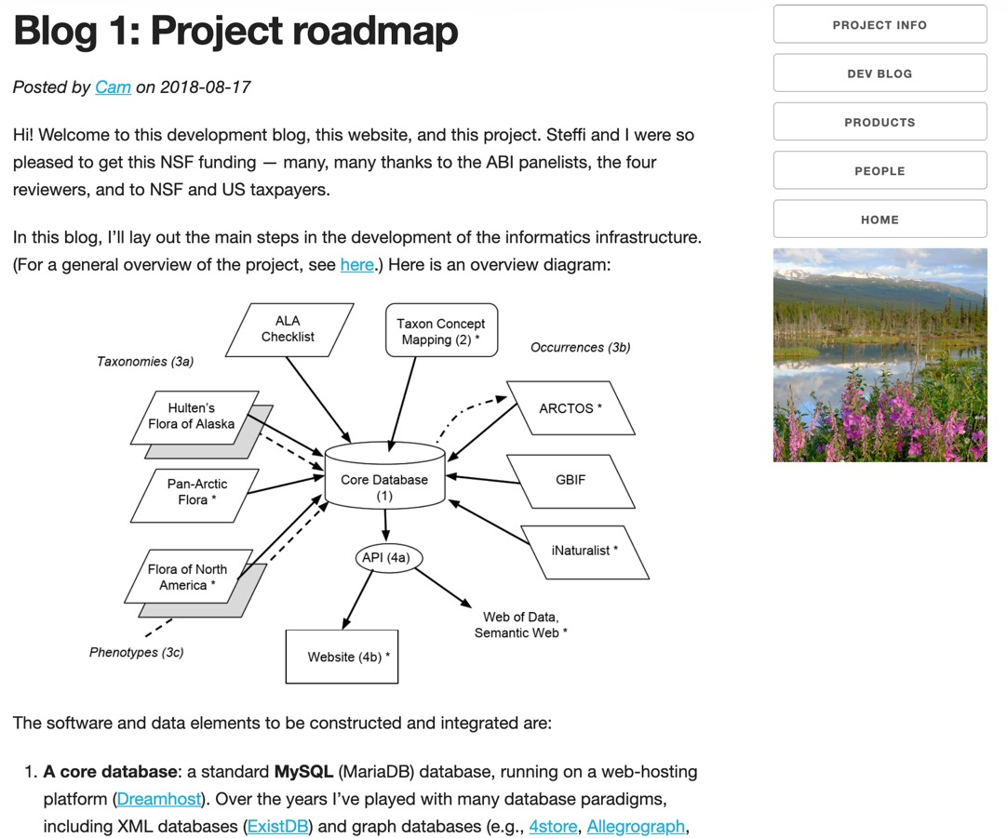
"Taxonomically intelligent data integration for a new Flora of Alaska"
NSF DBI 1759964
PIs Ickert-Bond & Webb
Reconciling Hulten, FNA & Pan-Arctic Flora
See http://alaskaflora.org/

Slide 58
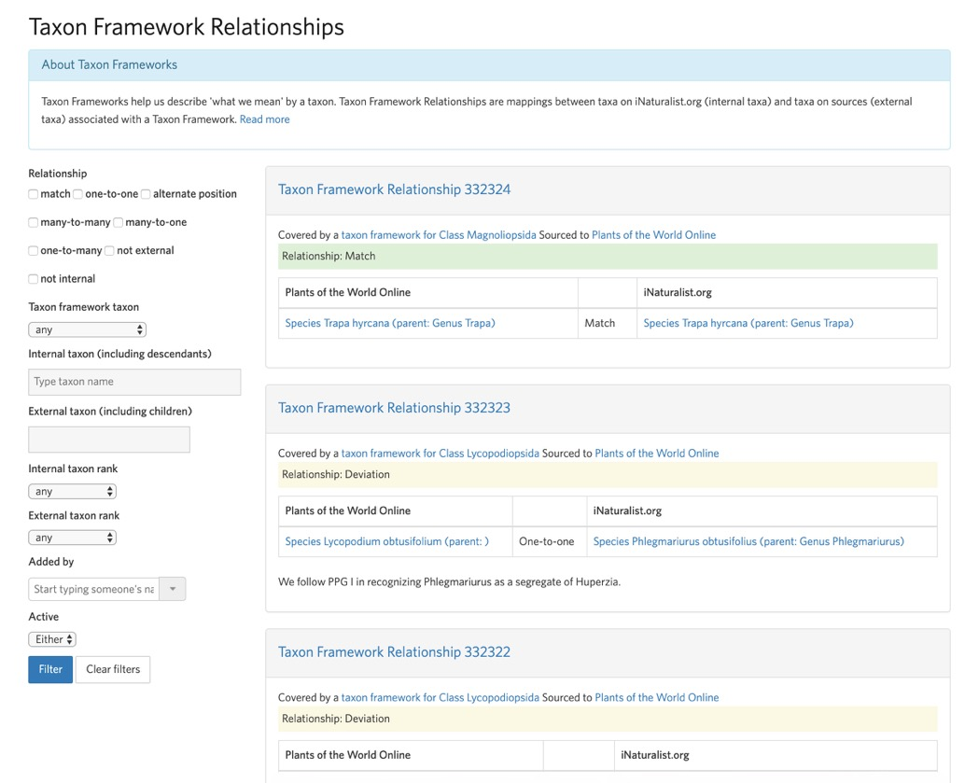
iNaturalist is mostly there already
https://www.inaturalist.org/taxon_framework_relationships

Slide 59
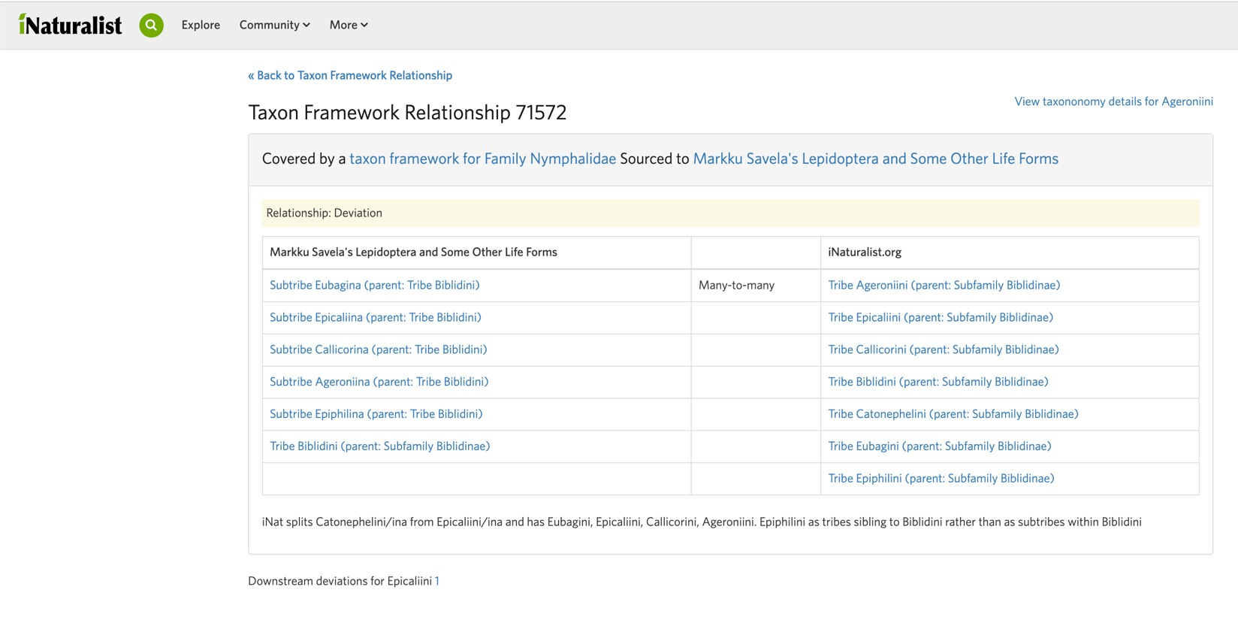
iNaturalist is mostly there already
https://www.inaturalist.org/taxon_framework_relationships

Slide 60
Recent addition: Concept alignment for phylogenomic trees
Franz, N.M. et al. 2019. Verbalizing phylogenomic conflict: […]. https://doi.org/10.1371/journal.pcbi.1006493

Slide 61
Reliable theories of multi-tree node congruence require expert judgment
"Synthesis"
OpenTree
vs. RCC–5
Franz, N.M. et al. 2019. Verbalizing phylogenomic conflict: […]. https://doi.org/10.1371/journal.pcbi.1006493

Slide 62
Hopeful conclusions
Key message: Biodiversity informatics remains young and fresh; especially if we aim
to incentivize experts/enthusiasts in publishing high-quality,
"data-intelligent" biodiversity data products.

Slide 63
Hopeful conclusions
Key message: Biodiversity informatics remains young and fresh; especially if we aim
to incentivize experts/enthusiasts in publishing high-quality,
"data-intelligent" biodiversity data products.
There are many grassroots or federally supported projects in this domain that express
enthusiasm for, and confidence in, a strong future for new, high-volume,
perpetually data-restructuring systematic research; driving our evolving
views of relations between DwC datasets and biological knowledge.

Slide 64
Hopeful conclusions
Key message: Biodiversity informatics remains young and fresh; especially if we aim
to incentivize experts/enthusiasts in publishing high-quality,
"data-intelligent" biodiversity data products.
There are many grassroots or federally supported projects in this domain that express
enthusiasm for, and confidence in, a strong future for new, high-volume,
perpetually data-restructuring systematic research; driving our evolving
views of relations between DwC datasets and biological knowledge.
If you have the passion and stomach for that future, join us now!

Slide 65

Acknowledgments
Gil Nelson, Alnycea Blackwell, Jillian Goodwin, and all other iDigBio and
Yale Peabody organizers and sponsors of #Digidata 2019.
ASU Biocollections & NEON Biorepository team.
Euler/X team: Bertram Ludäscher, Shizhuo Yu, Jessica Cheng.
If you wish to read one paper on aligning taxonomic concepts: https://doi.org/10.1093/sysbio/syw023

